Slide 1
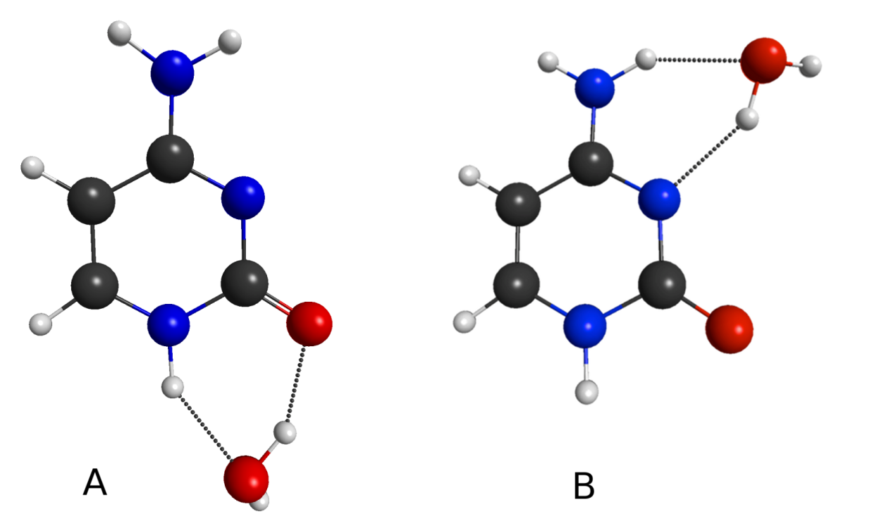
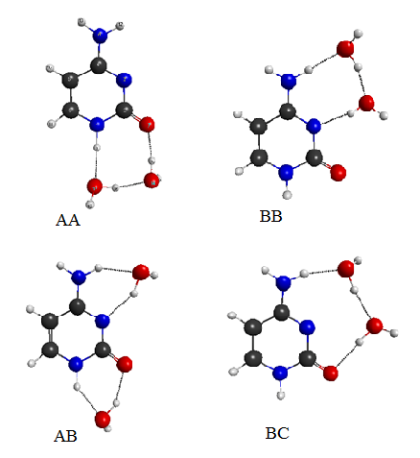
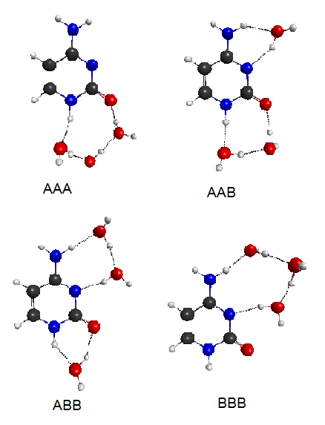
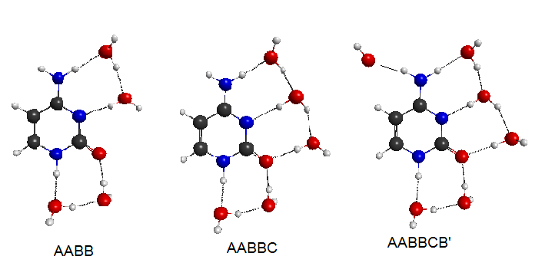
XIVth International Congress of Quantum Chemistry, Boulder, Colorado. June 25 - June 30, 2012.
Hydrates of Cytosine:
The Order of Binding Water Molecules
Figure 1. Monohydrates of cytosine
(canonical, amino-oxo tautomer)
Géza Fogarasi, Péter G. Szalay
Institute of Chemistry, Eötvös Loránd University, Budapest, H-1518, Pf. 32.
Introduction
Due to the tremendous significance of DNA-bases in molecular biology, every aspect of their structure of is of fundamental interest. We have been studying the structure and tautomerism of cytosine (Cyt) for some time. Currently we are investigating the electronic excited states of Cyt, in its “canonical” amino-oxo form, and hydrates of it [1]. As part of this study one needs first the geometries of the complexes with various numbers of water molecules, Cyt.nH₂O.
Table 1. Checking the level of theory: test calculations on the dihydrates, Cyt.(H₂O)₂.
 | Energies | AA | AB | BB | BC
Standard (Table 2) MP2(fc)/aug-cc-pVDZ | E/E_{h} + 546 Δ/kcal.mol⁻¹ | −0.47293 0 | -0.47221 0.45 | -0.47108 1.16 | -0.47023 1.69
Larger basis set MP2(fc)/aug-cc-pVTZ | E/E_{h} + 546 Δ/kcal.mol⁻¹ | −0.9418 0 | -0.9413 0.32 | -0.9399 1.19 | -0.9389 1.82
Coupled Cluster ª CCSD/aug-cc-pVDZ | E/E_{h}+ 546 Δ/kcal.mol⁻¹ | −0.54038 0 | -0.53955 0.52 | -0.53867 1.07 | -0.53813 1.41
Coupled Cluster ª CCSD(T)/aug-cc-pVDZ | E/E_{h}+ 546 Δ/kcal.mol⁻¹ | −0.61129 0 | -0.61046 0.52 | -0.60941 1.18 | -0.60875 1.59
DFT B3LYP/ aug-cc-pVDZ | E/E_{h}+ 547 Δ/kcal.mol⁻¹ | -0.92150 0 | -0.91966 1.15 | -0.91913 1.49 | -0.91740 2.57
DFT B3LYP/ aug-cc-pVTZ | E/E_{h}+ 548 Δ/kcal.mol⁻¹ | -0.05872 0 | -0.05681 1.20 | -0.05638 1.47 | -0.05473 2.50
Although numerous quantum chemical (QC) computations are available in the literature (e.g. [2,3]), a complete overview of the possible microhydrated forms is still needed. Specifically, the order of binding positions and individual binding energies are of interest. We label the sites around N1H−CO, N3−C−NH2 and N3−CO as A, B and C, respectively. Up to six water molecules were added to Cyt consecutively and their structures optimized. The complexes, with self-explaining notation, are are shown in Figures 1-4.
Figure 2. Dihydrates of cytosine
(canonical, amino-oxo tautomer)
ªSingle point energies in the standard MP2 geometry.
give 0.5 kcal/mol.) Among the dihydrates, AA has the lowest energy, AB lies just 0.4 − 0.5 kcal/mol higher. The binding energy of the latter is close to A + B, indicating good additivity: 12.77 + 12.05 = 24.82 ≅ 24.70, the direct value. AA and BB cannot be directly compared. The second water is analogous in the two, but its binding energy is 12.38 kcal/mol for the A ⇒ AA case, and smaller, 11.94 kcal/mol for B ⇒ BB.
In the trihydrates, AAB is already preferred to AAA by about 2.5 kcal/mol. This is explained by the much smaller binding energy of the third water in AAA than that of the first two water molecules: 9.49 kcal/mol, as compared to 12.77 and 12.38 kcal/mol, respectively.
For the oligohydrates, with 4, 5 and 6 water molecules we determined only one structure for each. On the basis of the above, these should be the favored arrangements. It is interesting to follow the consecutive binding energies of each additional water. When going from AAB to AABB, the fourth water still binds with 11.84 kcal/mol. In the pentahydrate, the fifth water goes to a new position, denoted C. In this structure, one water is protondonor in two H-bonds, and the CO oxygen becomes double proton acceptor. The binding is still strong, with Δ = 11.27 kcal/mol. It was not clear whether there is still place for a sixth water in the first hydration shell. We have found an energy minimum for a structure involving a H-bond with the other hydrogen of the amino group. However, the binding energy has dropped now significantly, to 7.11 kcal/mol.
Figure 4. Some oligohydrates of cytosine
(canonical, amino-oxo tautomer)
Figure 3. Trihydrates of cytosine
(canonical, amino-oxo tautomer)
Computational Details
The standard level of theory in this study was MP2(fc)/aug-cc-pVDZ. BSSE correction was not applied. MP2 and DFT geometry optimizations were done using PQS [4], while coupled cluster energies were obtained by CFOUR [5].
Results and Discussion
First, to check the stability of the results with respect to computational level, beside MP2 used as standard some DFT calculations have been added, and a larger basis set was also tested. On the dihydrates, single point energies were also computed at the CCSD(T) level. These test results are listed in Table 1.
It is reassuring to see that in all of the six sets of calculations, the order of energies is the same: AA < AB < BB < BC. The MP2 and coupled cluster results agree even quantitatively, with deviations within ~ 15%. At the same time, the DFT results differ from the wave function results by up to a factor of 2. Table 2 gives an overview of the final results. Comparing the two monohydrates, position A is favored relative to B, the energy difference being Δ(B−A) = 0.7 kcal/mol. (Higher level coupled cluster calculations [3]
Scheme 1. The order of successive binding positions of water molecules to cytosine. Binding energies in kcal/mol are given above the arrows, obtained after applying a constant BSSE error of 2.2 kcal/mol.
All the above were obtained without BSSE correction. From our earlier results on the monohydrates, the latter is 2.0 − 2.5 kcal/mol. However, for the individual water−binding energies BSSE should be fairly constant. Thus, applying an estimated correction of 2.2 kcal/mol, the order of binding water molecules to cytosine is summarized in Scheme 1.
Table 2. Energies of cytosine hydrates (E_{h}), MP2(fc)/aug-cc-pVDZ resultsª. Consecutive binding energies of water given in parentheses, and energy differences relative to the relevant most stable complexes given in square brackets (kcal/mol)^{b}.
H₂O | -76.26091
Cytosine | -393.91102
Cyt.H₂O E+470 Δ | A: -0.19228 (12.77) [0] |  | B: -0.19114 (12.05) [0.72] | A: -0.19228 | B: -0.19114 |  | B: -0.19114
Cyt.(H₂O)₂ E+546 Δ | AA: -0.47293 (12.38) [0] | AA: -0.47293 | AB: -0.47221 (12.65) [0.45] | AB: -0.47221 (11.94) | BB: -0.47108 (11.94) ) [1.16] | BB: -0.47108 | BC: -0.47023 (11.41) [1.69]
Cyt.(H₂O)₃ E+622 Δ | AAA: -0.74897 (9.49) [2.49] | AAB: -0.75294 (11.99) ) [0] | AAB: -0.75294 (12.44) | ABB: -0.75198 (11.83) [0.60] | ABB: -0.75198 (12.54) | BBB: -0.74871 (10.49) [2.65]
Cyt.(H₂O)₄ E+699 Δ |  | AABB: -0.03272 (11.84) |  | AABB: -0.03272 (12.44)
Cyt.(H₂O)₅ E+775 Δ |  | AABBC: -0.31160 (11.27)
Cyt.(H₂O)₆ E+851 Δ |  | AABBCB’:-0.58384 (7.11)
ª Eh (hartree)/molecule ≘ 627.5 kcal/mol. ^{b} Decrease of energy relative to: complex one cell above plus a free water). For better overview some values are given repeatedly. In square brackets: energy surplus relative to the lowest energy form in that row.
REFERENCES
1. Péter G. Szalay, Thomas Watson, Ajith Perera, Victor Lotrich, Géza Fogarasi,
Rodney J. Bartlett: Benchmark studies on the building blocks of DNA: II.
Effect of biological environment on the electronic excitation spectrum of nucleobases,
J. Pys. Chem. A, submitted.
2. Oleg V. Shishkin, Leonid Gorb, Jerzy Leszczynski: Does the Hydrated Cytosine Molecule
Retain the Canonical Structure? A DFT Study. J. Phys. Chem. B, 104, 5357-5361 (2000).
3. Geza Fogarasi, Peter G. Szalay: The interaction between cytosine tautomers and water:
an MP2 and coupled cluster electron correlation study. Chem. Phys. Lett., 356, 383-390 (2002).
4. PQS version 3.3, Parallel Quantum Solutions, 2013 Green Acres Road, Fayetteville, Ark.,
72703. 2011.
5. CFOUR, a quantum chemical program package written by J. F. Stanton, J. Gauss,
M. E. Harding, P. G. Szalay.
Acknowledgement. Financial support by the Hungarian Scientific Research Foundation (OTKA, Grant No. T68427) is gratefully acknowledged. The European Union and the European Social Fund have provided financial support to the project under the grant no. TAMOP 4.2.1./B-09/KMR-2010-0003.

